Slide 1

Modeling and Validation of Reflecting Metasurfaces for Improved mmWave Coverage
Master Thesis $2^{nd}$ Interim Presentation
Padmashree Reddy
Supervisor: Simon Häger
07.12.2023

Slide 2
Outline
Motivation
Methodology and Implementation
Results and Conclusion
Timeline
Thesis Table of Content

Slide 3
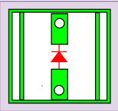

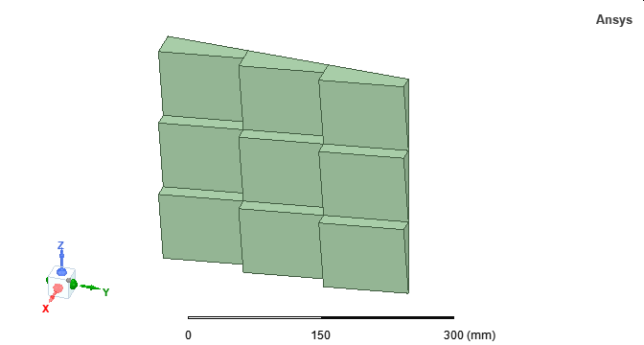

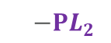

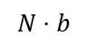

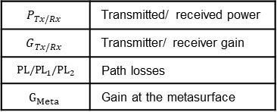
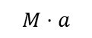




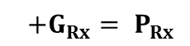

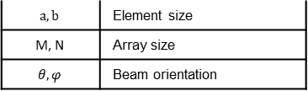
$$P_{Tx/Rx}$$ | Transmitted/ received power
$$G_{Tx/Rx}$$ | Transmitter/ receiver gain
$${ PL/PL}_{1}/{PL}_{2}$$ | Path losses
$$G_{Meta}$$ | Gain at the metasurface
Metasurfaces Deployment in mmWave Communication
Metasurfaces
Control board
$$a,b$$ | Element size
$$\text{M}\text{, }\text{N}$$ | Array size
$$θ,φ$$ | Beam orientation
Copper plate
Active
metasurface
IRS reflectors
$${PL}_{1}$$
BS
Passive
metasurface
Array of passive elements
$${PL}_{2}$$
$$PL$$
$$N⋅b$$
HELIOS reflectors
$$M⋅a$$
LOS: FSPL, UMi
NLOS: UMi
Typical communication link
$$P_{Tx}+G_{Tx}− PL+G_{Rx}= P_{Rx}$$
LOS
NLOS
VLOS
Communication link with metasurfaces
$$P_{Tx}+G_{Tx}$$
$$−{PL}_{1}$$
$$+G_{Meta}$$
$$−{PL}_{2}$$
$$+G_{Rx}= P_{Rx}$$
Radar equation

Slide 4


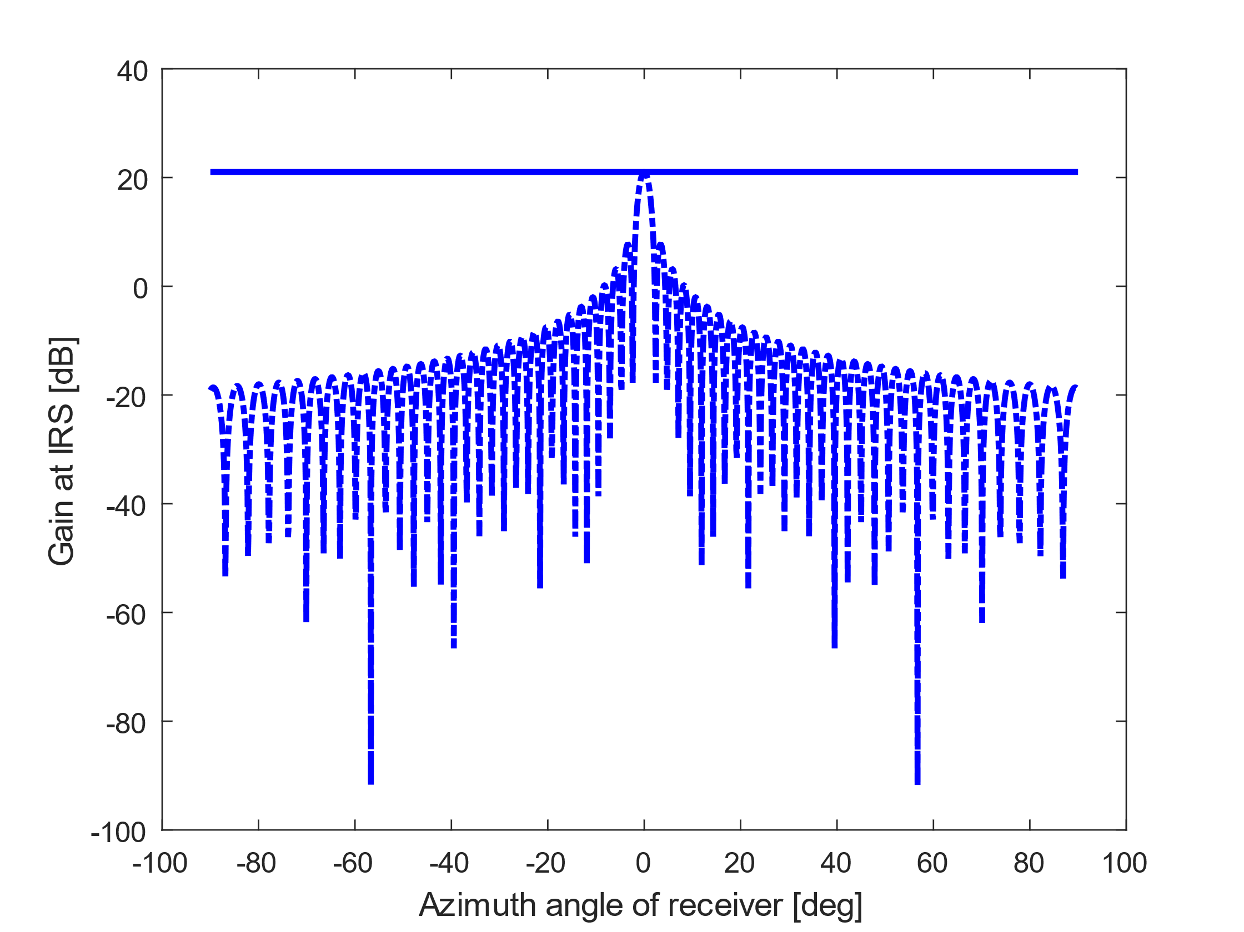
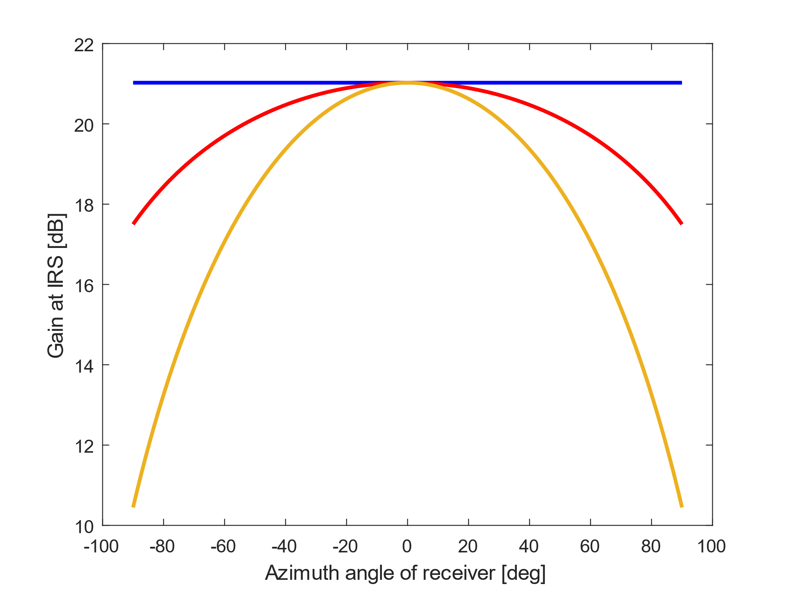
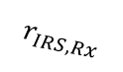
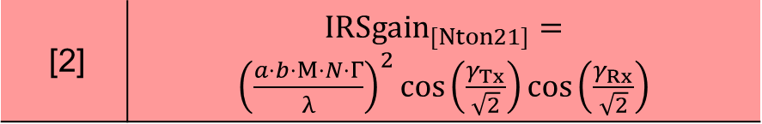
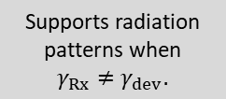
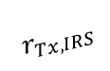
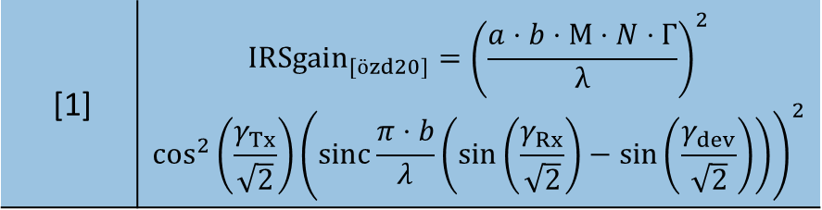

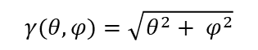
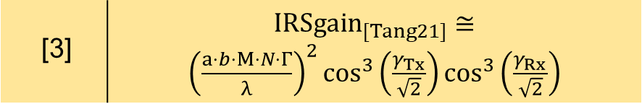
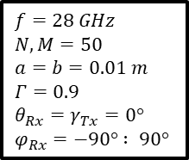

Existing IRS Models
$$Reflector$$
$$γ(θ,φ)=\sqrt{θ^{2}+ φ^{2}}$$
Tx
Rx
$$r_{Tx,IRS}$$
$$r_{IRS,Rx}$$
User is at angle where reflector is pointing at $γ_{Rx}=γ_{dev}$.
Models | Gain at the reflector
[1] | $${IRSgain}_{[özd20]}={\left(\frac{a⋅b⋅M⋅N⋅Γ}{λ}\right)}^{2}$$ $$\cos^{2}\left(\frac{γ_{Tx}}{\sqrt{2}}\right){\left(sinc⁡\frac{π⋅b}{λ}\left(\sin\left(\frac{γ_{Rx}}{\sqrt{2}}\right)−\sin\left(\frac{γ_{dev}}{\sqrt{2}}\right)\right)\right)}^{2}$$
Supports radiation patterns when $γ_{Rx}≠γ_{dev}.$
[2] | ${IRSgain}_{[Nton21]}={\left(\frac{a⋅b⋅M⋅N⋅Γ}{λ}\right)}^{2}cos\left(\frac{γ_{Tx}}{\sqrt{2}}\right)cos\left(\frac{γ_{Rx}}{\sqrt{2}}\right)$
[3] | ${IRSgain}_{[Tang21]}≅{\left(\frac{a⋅b⋅M⋅N⋅Γ}{λ}\right)}^{2}\cos^{3}\left(\frac{γ_{Tx}}{\sqrt{2}}\right)\cos^{3}\left(\frac{γ_{Rx}}{\sqrt{2}}\right)$
Loss of gain when reflecting away from surface normal.
$$f=28 GHz$$
$$N,M=50$$
$$a=b=0.01 m$$
$$Γ=0.9$$
$$θ_{Rx}=γ_{Tx}=0°$$
$$φ_{Rx}=−90° : 90°$$
[1] Ö. Özdogan, E. Björnson and E. G. Larsson, "Intelligent Reflecting Surfaces: Physics, Propagation, and Pathloss Modeling," in IEEE Wireless Communications Letters, vol. 9, no. 5, May 2020.
[2] K. Ntontin et al., "Optimal Reconfigurable Intelligent Surface Placement in Millimeter-Wave Communications," European Conference on Antennas and Propagation (EuCAP), March 2021.
[3] W. Tang et al., "Wireless Communications With RIS: Path Loss Modeling and Experimental Measurement," in IEEE Transactions on Wireless Communications, vol. 20, no. 1, Jan. 2021

Slide 5
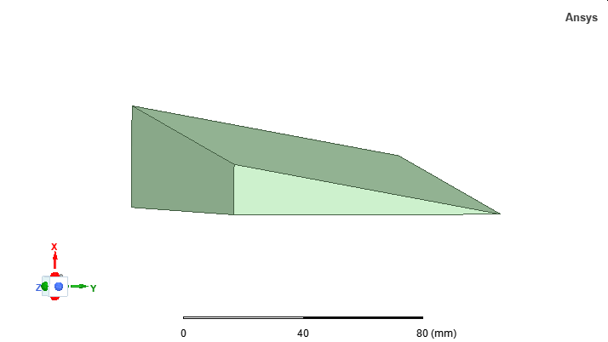
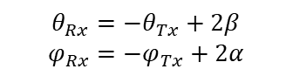
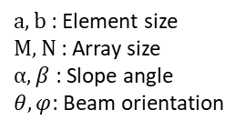
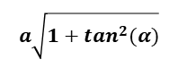
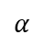

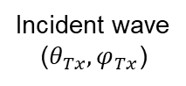

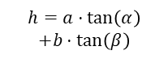
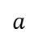
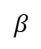
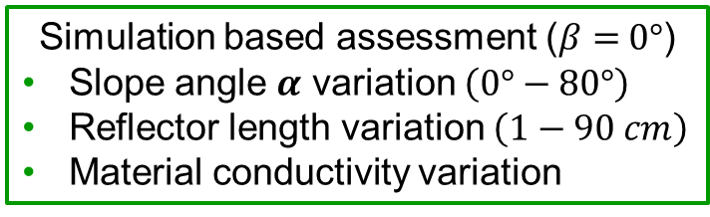

HELIOS Module Concept [4]
$a,b$: Element size
$M, N$: Array size
$α, β$ : Slope angle
$θ,φ$: Beam orientation
(kick-off presentation)
Reflecting
surface
Simulation based assessment ($β=$ $0°$)
Slope angle $α$ variation $\left(0°−80°\right)$
Reflector length variation $\left(1−90 cm\right)$
Material conductivity variation
b$\sqrt{1+\tan^{2}(β)}$
Incident wave
(${θ_{Tx},φ}_{Tx}$)
$$a\sqrt{1+\tan^{2}(α)}$$
$$θ_{Rx}=−θ_{Tx}+2β$$
$$φ_{Rx}=−φ_{Tx}+2α$$
Wall
surface
normal
(Transfer)
Reflector
surface
normal
(1st Interim presentation)
RCS analytical model for HELIOS
$σ_{module}({a,b,α, β, λ, θ}_{Tx},φ_{Tx},θ_{Rx},φ_{Rx}$)
Rectangular
flat plate
X
(Scope of thesis)
$$β$$
Z
Tuning RCS analytical model.
Performance analysis.
Evaluation with a case study.
$$h=a⋅\tan\left(α\right)$$
$$+b⋅\tan\left(β\right)$$
Y
$$α$$
$$b$$
$$a$$
[4] S. Häger, K. Heimann, S. Böcker and C. Wietfeld, "Holistic Enlightening of Blackspots With Passive Tailorable Reflecting Surfaces for Efficient Urban mmWave Networks," in IEEE Access, vol. 11, 2023.

Slide 6
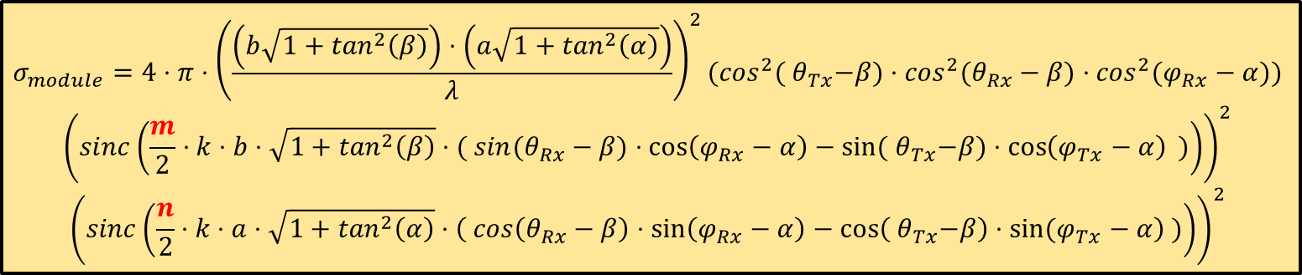
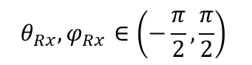
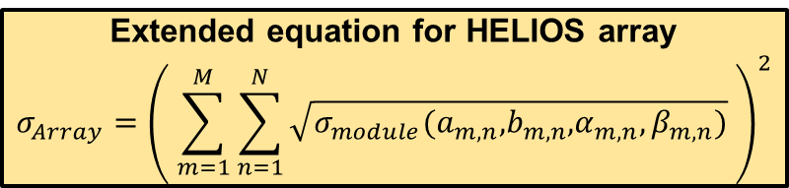
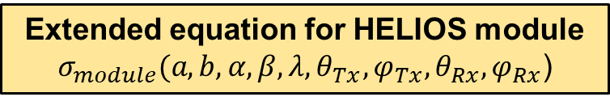
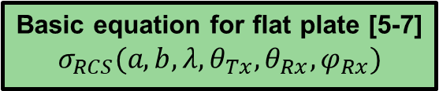
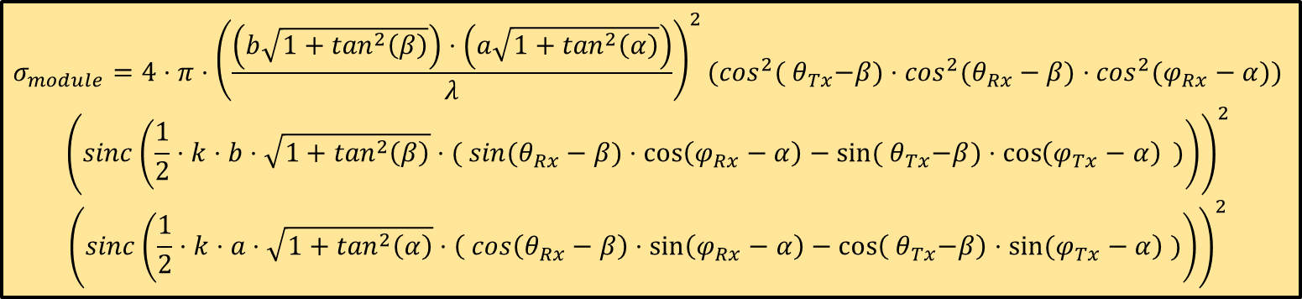
Analytical Modeling of HELIOS Element: Bistatic Radar-Cross-Section (RCS)
Basic equation for flat plate [5-7]
$$σ_{RCS}({a,b,λ, θ}_{Tx}, θ_{Rx},φ_{Rx})$$
Simulation feedback
Extended equation for HELIOS module
$$σ_{module}({a,b,α, β, λ, θ}_{Tx},φ_{Tx},θ_{Rx},φ_{Rx}\text{)}$$
Reflecting surface size
Supported angles
Rotation of reflecting surface
Beamwidth correction factor
$$σ_{module}=4⋅π⋅{\left(\frac{\left(b\sqrt{1+\tan^{2}\left(β\right)}\right)⋅\left(a\sqrt{1+\tan^{2}\left(α\right)}\right)}{λ}\right)}^{2}{(cos}^{2}({ θ}_{Tx}−β)⋅\cos^{2}(θ_{Rx}−β)⋅\cos^{2}(φ_{Rx}−α))$$
$${\left(sinc\left(\frac{1}{2}⋅k⋅b⋅\sqrt{1+\tan^{2}\left(β\right)}⋅( sin(θ_{Rx}−β)⋅\cos\left(φ_{Rx}−α\right)−sin⁡({ θ}_{Tx}−β)⋅\cos\left(φ_{Tx}−α\right) )\right)\right)}^{2}$$
$${\left(sinc\left(\frac{1}{2}⋅k⋅a⋅\sqrt{1+\tan^{2}\left(α\right)}⋅\left( cos\left(θ_{Rx}−β\right)⋅\sin\left(φ_{Rx}−α\right)−\cos\left({ θ}_{Tx}−β\right)⋅\sin{(φ_{Tx}−α}\right) )\right)\right)}^{2}$$
$$σ_{module}=4⋅π⋅{\left(\frac{\left(b\sqrt{1+\tan^{2}\left(β\right)}\right)⋅\left(a\sqrt{1+\tan^{2}\left(α\right)}\right)}{λ}\right)}^{2}{(cos}^{2}({ θ}_{Tx}−β)⋅\cos^{2}(θ_{Rx}−β)⋅\cos^{2}(φ_{Rx}−α))$$
$${\left(sinc\left(\frac{m}{2}⋅k⋅b⋅\sqrt{1+\tan^{2}\left(β\right)}⋅( sin(θ_{Rx}−β)⋅\cos\left(φ_{Rx}−α\right)−sin⁡({ θ}_{Tx}−β)⋅\cos\left(φ_{Tx}−α\right) )\right)\right)}^{2}$$
$${\left(sinc\left(\frac{n}{2}⋅k⋅a⋅\sqrt{1+\tan^{2}\left(α\right)}⋅\left( cos\left(θ_{Rx}−β\right)⋅\sin\left(φ_{Rx}−α\right)−\cos\left({ θ}_{Tx}−β\right)⋅\sin{(φ_{Tx}−α}\right) )\right)\right)}^{2}$$
Extended equation for HELIOS array
$$σ_{Array}={\left( \sum_{m=1}^{M}{\sum_{n=1}^{N}{\sqrt{σ_{module}\text{(}a_{m,n}\text{,}b_{m,n}\text{,}α_{m,n},β_{m,n}\text{)}}}} \right)}^{2}$$
$$θ_{Rx},φ_{Rx}∈\left(−\frac{π}{2},\frac{π}{2}\right)$$
[5] C.A. Balanis, Advanced Engineering Electromagnetics, 2nd ed. John Wiley & Sons, April, 2012.
[6] D. E. Kerr, S. A. Goudsmit, L. B. Linford, and A.M. Stone, Eds., Propagation of Short Radio Waves, ser. Electromagnetics and Radar. Institution of Engineering and Technology, April. 1987.
[7] S. Häger, K. Heimann, S. Böcker, C. Wietfeld, "Holistic Enlightening of Blackspots with Passive Tailorable Reflecting Surfaces for Efficient Urban mmWave Networks," In IEEE Access, vol. 11.

Slide 7
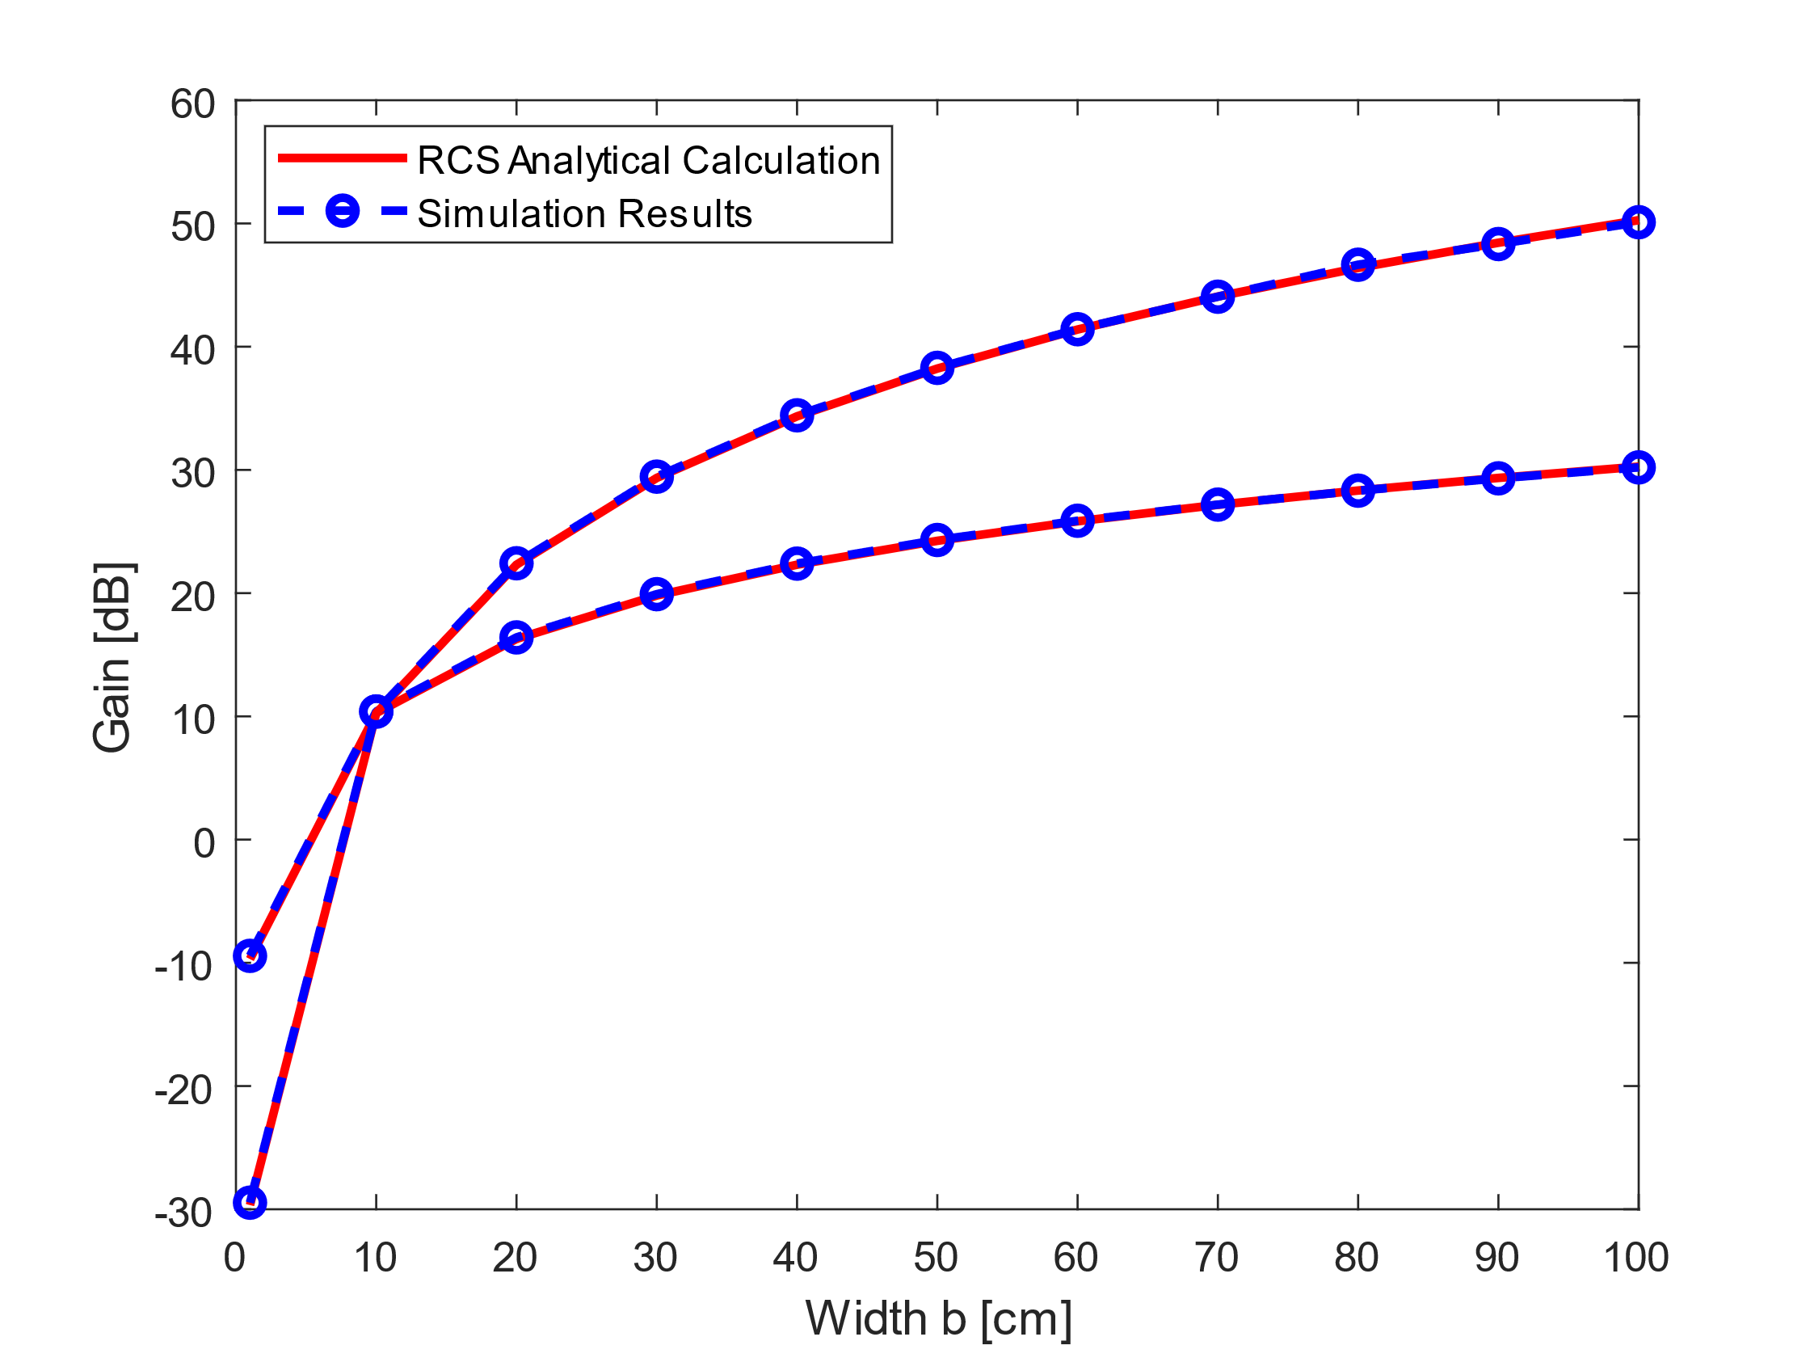
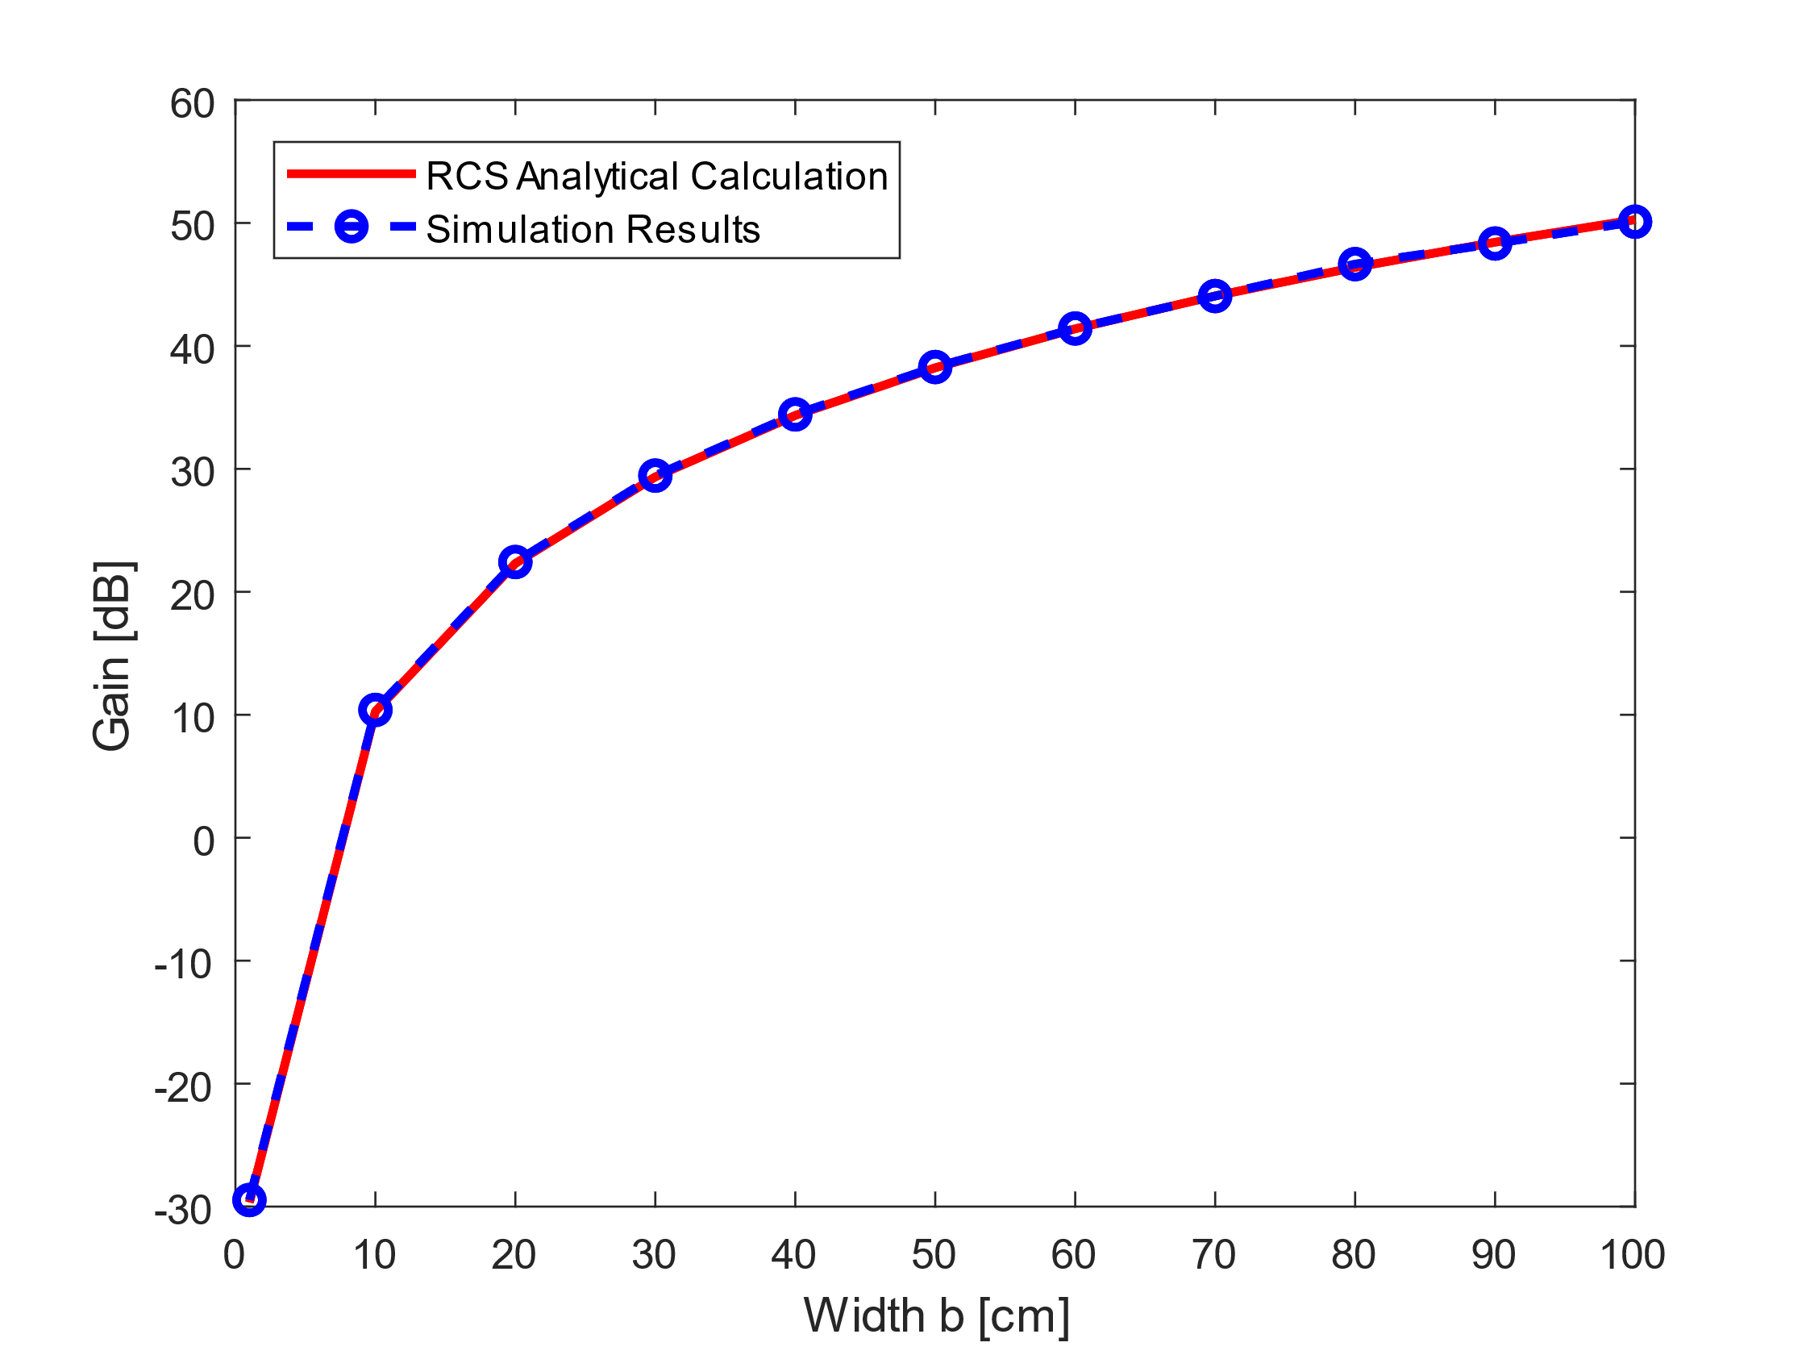
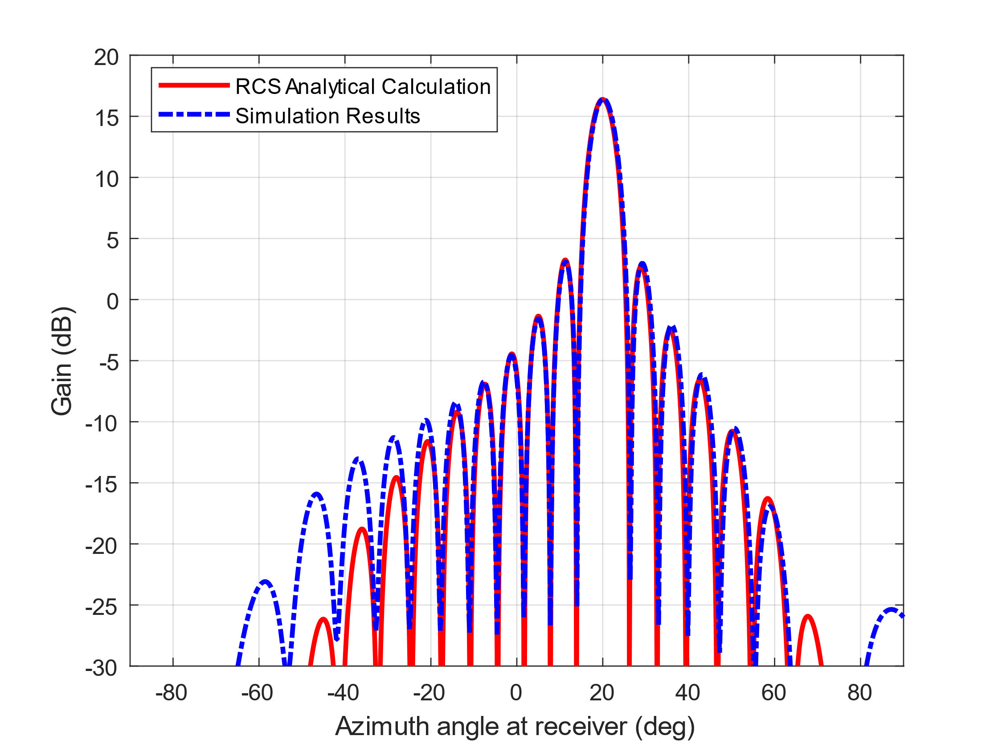


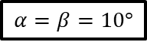
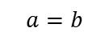
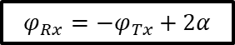
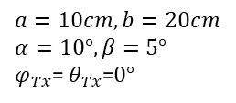
Comparison of Analytical and Simulated Values
$$a=10cm, b=20cm$$
$$α=10°, β=5°$$
$φ_{Tx}$= $θ_{Tx}$=$0°$
$$α=β=10°$$
$$a=b$$
Gain of main and sidelobes match.
$$a=10cm$$
Mismatch
Gain increases with reflector size.
$$φ_{Rx}=−φ_{Tx}+2α$$
Simulated and analytical model match as desired!

Slide 8
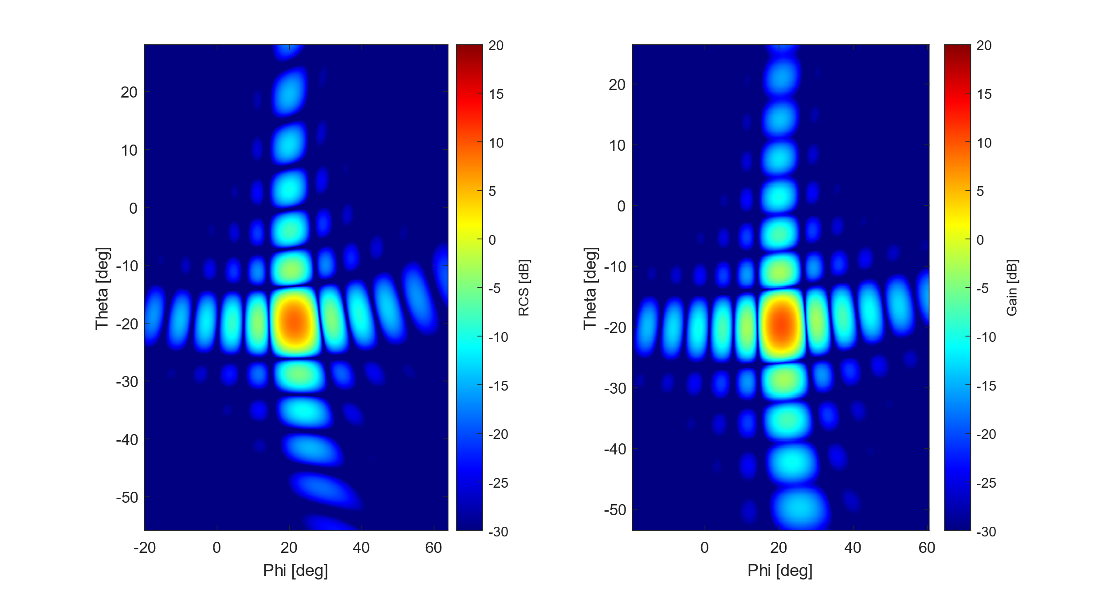
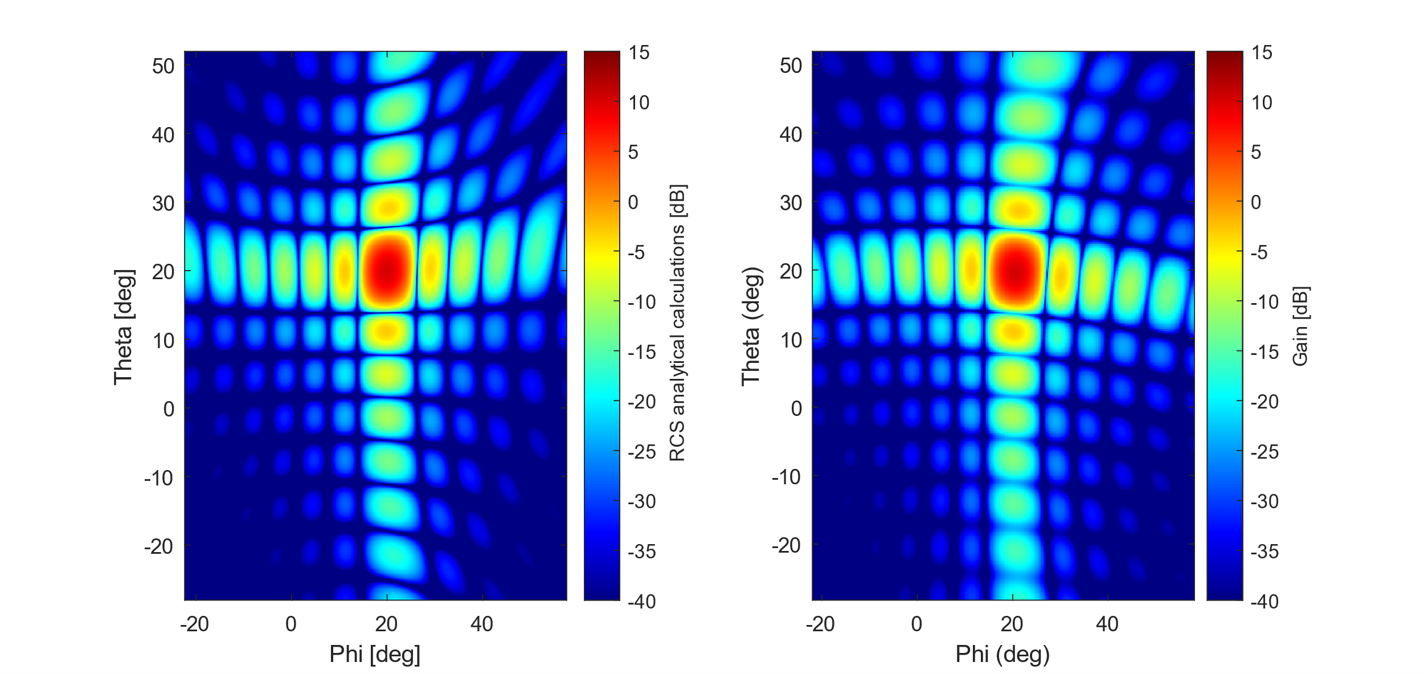
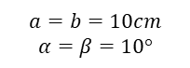
Heatmap Comparison of Analytical and Simulations: HELIOS Reflector Element
$$a=b=10cm$$
$$α=β=10°$$
Analytical
Simulations
Changes has been made while revising the model.
Previous analytical model
Main lobe and side lobes match
0
-10
-20
-30
-40
-50
Theta [deg]
Gain [dB]
Theta [deg]
Theta [deg]
Theta [deg]
-10 0 10 20 30 40
Phi [deg]
Phi [deg]

Slide 9
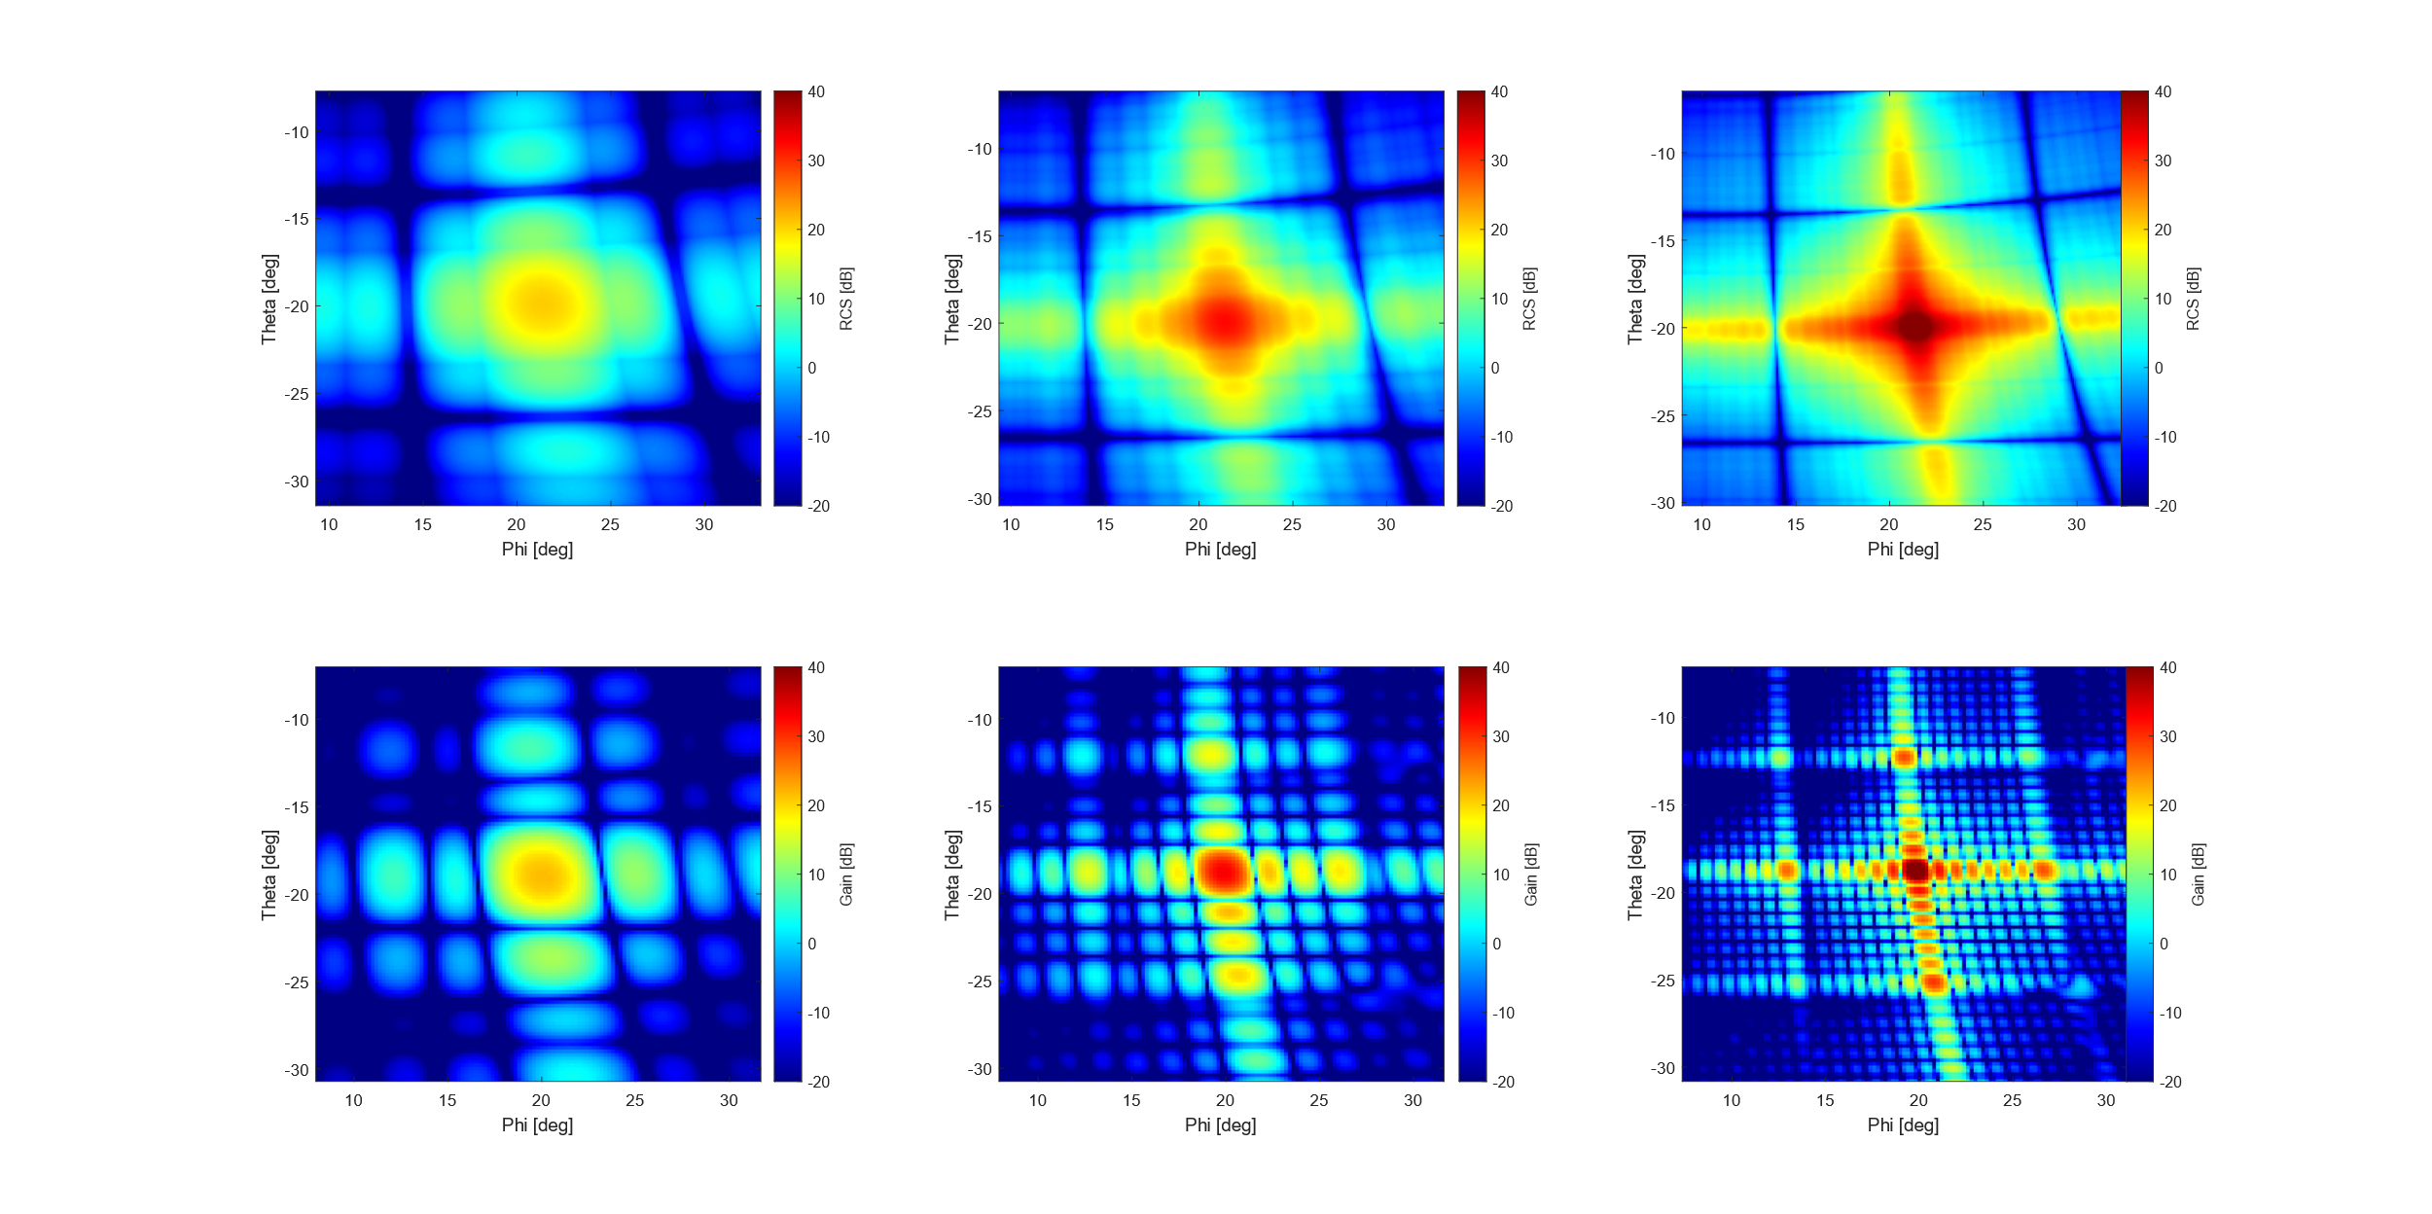
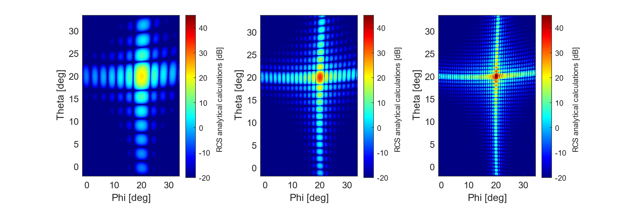
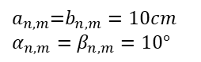
Heatmap Comparison of Varied Analytical and Simulated Values:
$$a_{n,m}\text{=}b_{n,m}=10cm$$
$$α_{n,m}=β_{n,m}=10°$$
2x2 HELIOS
4x4 HELIOS
8x8 HELIOS
Beams get narrower with higher gains.
Analytical
Lot of similarities can be observed.
Gain [dB]
Theta [deg]
But
RCS model doesn’t account for diffractions, as the model is kept simple.
Simulations
Phi [deg]

Slide 10
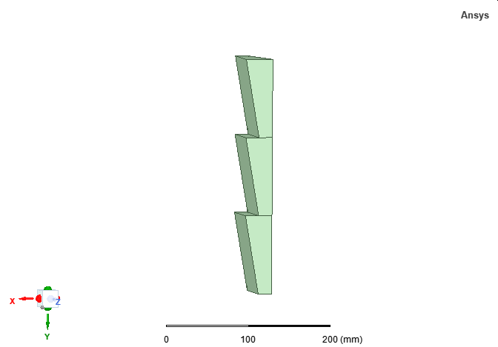
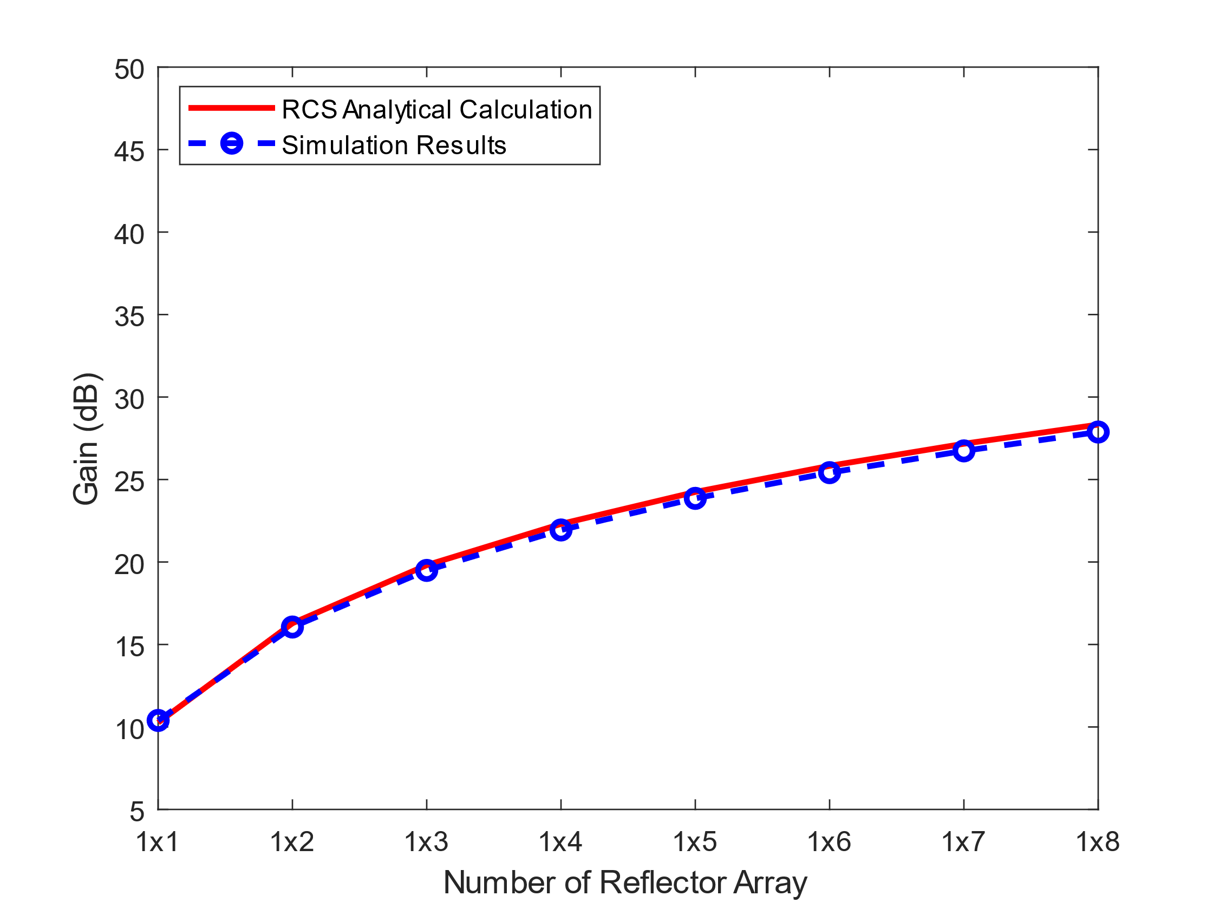
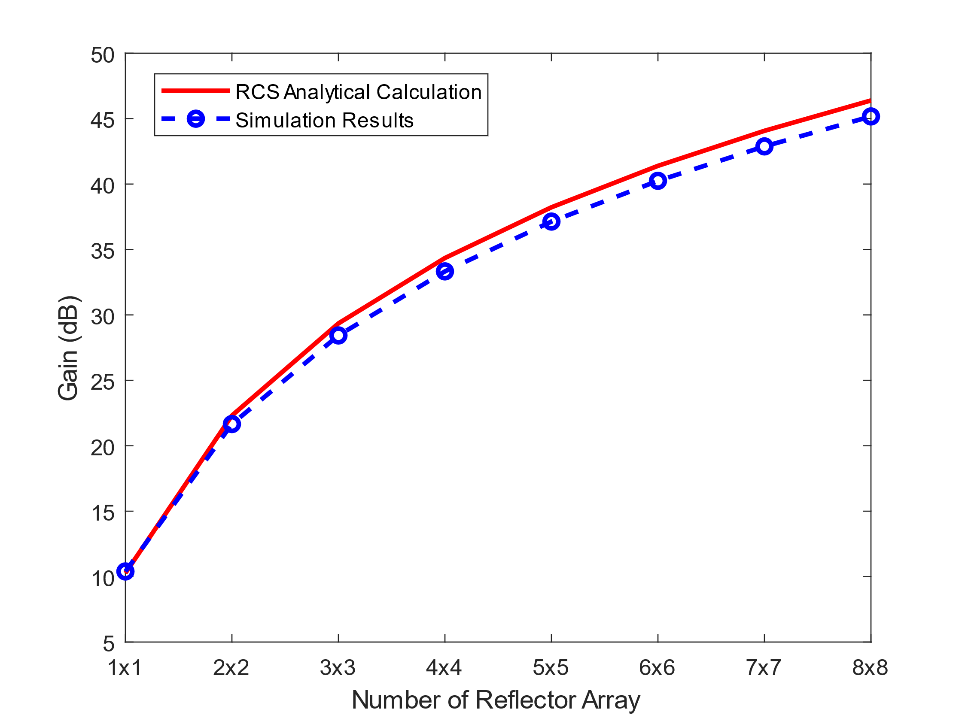










Comparison of Analytical and Simulated Values: Reflector Array [8]
$$a_{n,m}\text{=}b_{n,m}=10cm$$
$$α_{n,m}=β_{n,m}=10°$$
Reflected wave $(θ,φ)$
0.4 dB
$$η\%$$
1.2 dB
Transmitted wave $(θ,φ)$
$$η\%$$
Shadowed region
$1×N$ array
$M×N$ array
X
Optimized equation for HELIOS module
Z
$$σ_{module}(a^{∗}{,b^{∗}, α, β, λ, θ}_{Tx},φ_{Tx},θ_{Rx},φ_{Rx})$$
Where $η$ is shadowing factor
$$a^{∗}=\left(1−η\right)⋅a$$
$$b^{∗}=(1−η)⋅b$$
$$σ_{module} ({a,b,α, β, λ, θ}_{Tx},φ_{Tx},θ_{Rx},φ_{Rx}\text{)}$$
Where $η$ is shadowing factor
Y
[8] M. I. Skolnik, "Radar Handbook," 3rd ed., New York, NY, USA: McGraw-Hill, 2008.

Slide 11

















Addressing Self-Shadowing Regions
$$a_{n,m}\text{=}b_{n,m}=10cm$$
$$β_{n,m}=β_{m,n+1}=10°$$
$α_{m,n}=$ $α_{m,n+1}=10°$
Case 2
$$φ_{Tx}≤0°$$
$$φ_{Tx}>0°$$
$$α_{m,n}<0°$$
$$α_{m,n+1}<0°$$
Case 1
Case 3
$$α_{m,n} >0°$$
$$α_{m,n+1}<0°$$
$$α_{m,n} >0°$$
$$α_{m,n+1} >0°$$
Case 4
$$α_{m,n}<0°$$
$$α_{m,n+1} >0°$$
$$η_{a_{m,n}}=\frac{a_{m,n+1}}{a_{m,n}}⋅\tan\left(α_{m,n+1}\right)⋅\frac{\sin\left(φ_{Tx}\right)}{\cos\left(−φ_{Tx}+α_{m,n}\right)},φ_{Tx}>0°$$
$$φ_{Tx}>0°$$
$$η_{a_{m,n+1}}=0 , φ_{Tx}>0°$$
$$η_{a_{m,n}}=\left\{\begin{aligned}\frac{a_{m,n+1}}{a_{m,n}}⋅\tan\left(α_{m,n+1}\right)⋅\frac{\sin\left(−φ_{Tx}+2{⋅α}_{m,n}\right)}{\cos\left(−φ_{Tx}+α_{m,n}\right)},φ_{Tx}>−90°+α_{m,n} \\ 1 , { φ}_{Tx}<−90°+α_{m,n}\end{aligned}\right.$$
$$φ_{Tx}≤0°$$
$$η_{a_{m,n+1}}=\left\{\begin{aligned}0,φ_{Tx}>−90°+α_{m,n} \\ 1,{ φ}_{Tx}<−90°+α_{m,n}\end{aligned}\right.$$

Slide 12


















Addressing Self-Shadowing Regions
Future work.
M,1 |  |  | M,N
. |  | .
. | .
1,1 | . | . | 1,N
Pairwise realization in each column $(β_{m,n},β_{m+1,n},$ and ${ θ}_{Tx}$).
Pairwise realization in each row
($α_{m,n},α_{m,n+1},\text{and}{ φ}_{Tx})$.
$$η_{a_{m,n}}=\left\{\begin{aligned}0,φ_{Tx}<90°+α_{m,n} \\ 1,{ φ}_{Tx}>90°+α_{m,n}\end{aligned}\right.$$ | $$η_{a_{m,n+1}}=\left\{\begin{aligned}\frac{a_{m,n+1}}{a_{m,n}}⋅\tan\left(α_{m,n+1}\right)⋅\frac{\sin\left(−φ_{Tx}+2{⋅α}_{m,n}\right)}{\cos\left(−φ_{Tx}+α_{m,n}\right)},φ_{Tx}<90°+α_{m,n} \\ 1 , { φ}_{Tx}>90°+α_{m,n}\end{aligned}\right.$$
$$φ_{Tx}>0°$$
$$α_{m,n}<0°$$
$$α_{m,n+1}<0°$$
$$φ_{Tx}≤0°$$
$$η_{a_{m,n}}=0 ,φ_{Tx}<0°$$ | $$η_{a_{m,n+1}}=\frac{a_{m,n−1}}{a_{m,n}}⋅\tan\left(α_{m,n−1}\right)⋅\frac{\sin\left(φ_{Tx}\right)}{\cos\left(−φ_{Tx}+α_{m,n}\right)} , φ_{Tx}<0°$$
$$η_{a_{m,n}}=\left\{\begin{aligned}0, { φ}_{Tx}<90°+α_{m,n+1} \\ \frac{a_{m,n+1}⋅\sqrt{1+\tan^{2}{α_{m,n+1}}}}{a_{m,n}}\frac{\sin\left(φ_{Tx}+α_{m,n+1}−90°\right)}{\cos\left(−φ_{Tx}+α_{m,n}\right)},{ φ}_{Tx}>90°+α_{m,n+1}\end{aligned}\right.$$ | $$η_{a_{m,n+1}}=\left\{\begin{aligned}0,φ_{Tx}<90°+α_{m,n} \\ 1,{ φ}_{Tx}>90°+α_{m,n}\end{aligned}\right.$$
$$φ_{Tx}>0°$$
$$α_{m,n} >0°$$
$$α_{m,n+1}<0°$$
$$φ_{Tx}≤0°$$
$$η_{a_{m,n}}=\left\{\begin{aligned}0,φ_{Tx}>−90°+α_{m,n} \\ 1,{ φ}_{Tx}<−90°+α_{m,n}\end{aligned}\right.$$ | $$η_{a_{m,n+1}}=\left\{\begin{aligned}0, { φ}_{Tx}>−90°+α_{m,n−1} \\ \frac{a_{m,n−1}⋅\sqrt{1+\tan^{2}{α_{m,n−1}}}}{a_{m,n}}\frac{\sin\left(φ_{Tx}+α_{m,n−1}−90°\right)}{\cos\left(−φ_{Tx}+α_{m,n}\right)},{ φ}_{Tx}<−90°+α_{m,n−1}\end{aligned}\right.$$
$$φ_{Tx}>0°$$
$$η_{a_{m,n}}=\left\{\begin{aligned}0,φ_{Tx}<90°−α_{m,n} \\ 1,{ φ}_{Tx}>90°−α_{m,n}\end{aligned}\right.$$ | $$η_{a_{m,n+1}}=0 ,φ_{Tx}>0°$$
$$α_{m,n}<0°$$
$$α_{m,n+1} >0°$$
$$φ_{Tx}≤0°$$
$$η_{a_{m,n}}=0 ,φ_{Tx}>0°$$ | $$η_{a_{m,n+1}}=\left\{\begin{aligned}0,φ_{Tx}>−90°+α_{m,n} \\ 1,{ φ}_{Tx}<−90°+α_{m,n}\end{aligned}\right.$$

Slide 13








Comparison of Analytical and Simulated Values: Reflector Array [8]
$$a_{n,m}\text{=}b_{n,m}=10cm$$
$$α_{n,m}=β_{n,m}=10°$$
Reflected wave $(θ,φ)$
0.02 dB
0.4 dB
$$η\%$$
0.2 dB
1.2 dB
Transmitted wave $(θ,φ)$
$$η\%$$
Shadowed region
X
1xN array
MxN array
Z
Optimized equation for HELIOS module
$$a^{∗}=\left(1−η\right)⋅a$$
$$b^{∗}=(1−η)⋅b$$
$$σ_{module}(a^{∗}{,b^{∗}, α, β, λ, θ}_{Tx},φ_{Tx},θ_{Rx},φ_{Rx})$$
Where $η$ is shadowing factor
Y
[8] M. I. Skolnik, "Radar Handbook," 3rd ed., New York, NY, USA: McGraw-Hill, 2008.

Slide 14
Analytical model
(Complete)
Analytical fits simulation results (e.g., gain and beamwidth).
HELIOS array considers shadowing effect along rows and columns.
(Out of scope)
Diffraction characteristic and more complex shadowing behavior along diagonal.
(Next step)
Performance evaluation
Computing time analysis.
Integration into channel model.
Transferring model to urban case study.
Comparing HELIOS to IRS models.
Comparing simulated and analytical models in urban case study.

Slide 15








Time Measurements for a HELIOS Module
Variable changes: ${ α, β, θ}_{Tx},φ_{Tx}$
Number of simulations: 100
$X$: Speed up factor
$$a=b=10cm$$
$2^{∘}$Resolution ${ 1}^{∘}$Resolution ${ 0.5}^{∘}$Resolution
Simulated Analytical
$$X≥4$$
$$X≥14681$$
$$X≥25666$$
Mean calculation time | Simulated | Analytical
$2^{∘}$ Resolution | 32.3 (s) | 2.2 (ms)
$1^{∘}$ Resolution | 106.3 (s) | 6.1 (ms)
${0.5}^{∘}$ Resolution | 400.4 (s) | 15.6 (ms)
(Simulation with 4 CPU cores)

Slide 16













Time Measurement Dependency on Reflector Size and Array
Simulations
Analytical
1800
1400
1200
1000
800
600
400
200
0
Simulations
$$X≥38$$
$$X≥1$$
Time measurements [s]
Barely an impact on reflector size.
Time measurements at $2^{∘}$ Resolution [s]
$X≥70$609
$$X≥24$$
0.025
0.02
0.015
0.01
0.005
0
Analytical
$$X≥10$$
High energy efficient.
Reflector size a,b [m]
$$1×1$$
$$2×2$$
$$4×4$$
Advantage of analytical model: Accurate modeling of reflection model at less computational cost and delay.
Reflector Array

Slide 17








Channel Modeling: Radar Path Loss Realization
$D_{Tx−Ref}:$Tx-Ref distance
$D_{Ref−Rx}$: Ref-Rx distance
$D_{Tx−Rx}$: Tx-Rx distance
Reflector location: $50 m$
Equation | Linear | dB
FSPL | $$\frac{λ^{2}}{{\left(4⋅π⋅D_{Tx−Rx}\right)}^{2}}$$ | $$−147. 5 \left[dB\right]+20⋅log_{10}\left(D_{Tx−Rx}\right)+20⋅log_{10}\left(f\right)$$
Radar | $$\frac{λ^{2}⋅σ_{Meta}}{{\left(4⋅π\right)}^{3}D_{Tx−Ref}^{2}D_{Ref−Rx}^{2}}$$ | $$−136.5 \left[dB\right]+20⋅log_{10}\left(D_{Tx−Ref}\right)+20⋅log_{10}\left(D_{Ref−Rx}\right)+20⋅log_{10}\left(f\right)−σ_{Meta}$$
$PL_{Radar}=PL_{Tx−Ref}+PL_{Ref−Rx}$ $−σ_{Meta}− ΔD$
$ΔD_{FSPL}=$ $10⋅log_{10}\left(\text{4}⋅π\right)−20⋅log_{10}\left(c\right)$ $+20⋅log_{10}\left(f\right)$
$σ_{Meta}$= $0 dBsm$
$ΔD_{UMi}=57.2 [dB]−20⋅log_{10}\left(c\right)$ $+20⋅log_{10}\left(f\right)$
160
$∝$ Reflector location
FSPL LOS
150
FSPL Radar
140
130
Path Loss [dB]
$$σ_{Meta}$$ | Values [$dBsm$]
Man | 0
Small bird | -20
Car | 20
Large commercial airplane | 20
Small fighters | 3
120
Approx. $50 dB$
110
Approx. $13 dB$
100
90
80
10
20
30
40
50
60
70
80
90
100
Distance Tx-Rx [m]

Slide 18
Urban Scenario Case Study

Slide 19



Urban Scenarios Implementation
Parameter | Values
Power transmitted | $$20.3 dBm$$
Gain | $$19.7 dBi$$
Position $(x, y, z)$ | $$(309.9 m, 170.1 m, 10.0 m)$$
$$D_{Tx−Ref}$$ | $$115 m$$
Beam orientations $(φ_{Tx},θ_{Tx})$ | $$({80.17}^{∘},{2.46}^{∘})$$
Gain | $$13.5 dBi$$
Position grid center $(x, y, z)$ | $$(180 m, 180 m, 1.5 m)$$
Grid size $(x×y)$ | $$120.0 m×120.0 m$$
Grid density | $1 m$uniform spacing
$$\text{Beam} \text{o}\text{rientation} \text{range} (φ_{Rx},θ_{Rx})$$ | $$φ_{Rx}: ({−85.6}^{∘},{87.3}^{∘})$$ $θ_{Rx}$: $({−87.1}^{∘},{86}^{∘})$
$D_{Ref−Rx}$ range | $$3.5 m −102.65 m$$
Sensitivity $S_{Rx}$ | -83.5 dBm
Position grid center $(x, y, z)$ | $$(195 m, 170 m, 5m)$$
Footprint size $(x×y)$ | $$3.0 m×3.0 m$$
Number of reflectors | $$1×32$$
Receiver Grid
Houses
NLOS
Metasurface
Houses
Outage
Transmitter
Tx
Streets
LOS
Receiver
Region of interest
Goal: $P_{Rx}>S_{Rx}$
Houses
Houses
Reflector
[4] S. Häger, K. Heimann, S. Böcker and C. Wietfeld, "Holistic Enlightening of Blackspots With Passive Tailorable Reflecting Surfaces for Efficient Urban mmWave Networks," in IEEE Access, vol. 11, 2023.

Slide 20









Urban Scenario Reflector Gains
15
10
5
0
-5
-10
-15
-20
240
220
200
180
160
140
120
Narrow
Broad
Max gain from the reflector at ${φ_{out}=−25}^{∘}$ .
Passive metasurface
( HELIOS model [4] )
Y- Position [m]
Gain [dB]
$α_{1}, ….,α_{32}={27.6}^{∘}$: Narrow beams
$α_{1}, ….,α_{32}∈[{17.6}^{∘}, {32.6}^{∘}]$: Broad beams
120 140 160 180 200 220 240
120 140 160 180 200 220 240
HELIOS don’t consider elevation yet.
Active metasurface
( IRS models [1-3] )
240
220
200
180
160
140
120
240
220
200
180
160
140
120
Model 1
Model 2
Model 3
Model 1
Constant gain as $γ_{Rx}=γ_{dev}$.
$$γ_{Rx}≠γ_{dev}$$
$$γ_{Rx=−{25}^{∘}}$$
Y- Position [m]
Gain [dB]
Y- Position [m]
Supports radiation pattern.
Varied gains in a controllable manner.
120 140 160 180 200 220 240
120 140 160 180 200 220 240
120 140 160 180 200 220 240
120 140 160 180 200 220 240
X- Position [m]
X- Position [m]

Slide 21





Power Received in Urban Scenario for IRS Model 3: FSPL Radar Realization
Max power received:
Approx. $−45 dB$
Max power received:
Approx. $−13 dB$
Max power received:
Approx. $35 dB$
240
220
200
180
160
140
120
Power Received [dB]
Y- Position [m]
120 140 160 180 200 220 240
120 140 160 180 200 220 240
120 140 160 180 200 220 240
X- Position [m]
Power received without reflector.
Power received with reflector.
Delta power received.
$$ΔP_{Rx}=P_{WithReflector}−P_{WithoutReflector}$$

Slide 22




Power Received in Urban Scenario
$$γ_{Rx}≠γ_{dev}$$
$$γ_{Rx=−{25}^{∘}}$$
240
220
200
180
160
140
120
Narrow
Broad
Model 1
Y- Position [m]
HELIOS behaves similarly to the desired region of interest like in IRS.
Delta Power Received [dB]
120 140 160 180 200 220 240
120 140 160 180 200 220 240
120 140 160 180 200 220 240
240
220
200
180
160
140
120
Model 1
$$γ_{Rx}=γ_{dev}$$
Model 2
Model 3
But IRS serves a lot more regions, as they can dynamically redirect signals to the user location.
Y- Position [m]
120 140 160 180 200 220 240
120 140 160 180 200 220 240
120 140 160 180 200 220 240
X- Position [m]

Slide 23




Urban Scenario Comparison: Analytical and Simulated Models
Analytical model
Simulations
20
10
0
-10
Narrow Broad
Concentrated main lobe
Simulated Analytical
Narrow beams
50
40
30
20
10
0
-10
-20
-30
Theta [deg]
+8.5 dB
+9 dB
More to the right,
better the performance.
+11 dB
+6.5 dB
-40 -20 0 20
-40 -20 0 20
20
10
0
-10
Phi [deg]
Gain [dB]
Theta [deg]
Multiple side lobes
Broad beams
-40 -20 0 20
-40 -20 0 20
$Gain_{MAX}$ [$dB$] | Analytical | Simulation
Narrow beams | $$54.79$$ | $$52.94$$
Broad beams | $$41.05$$ | $$48.75$$
Phi [deg]
Analytical model is over predicting the reflection pattern.

Slide 24



CDF Analysis for HELIOS Array
More to the right,
better the performance.
$1x1 2x2 4x4 8x8$
Simulated Analytical
Gains of
simulation data > analytical data.
No over prediction by analytical modeling.
Outlook: To investigate the over prediction of power in the urban case study by analytical model.
Contrasting the results in the previous slide.

Slide 25
4. Timeline
Stage 1
Literature reading
Stage 3
Implementation, Reinterpretation of IRS models
Stage 4
Familiarization with a thesis template
Preparation of kickoff presentation
HELIOS simulation with Ansys HFSS
Evaluating HELIOS model according to design requirement.
Complete master thesis.
Preparation of the final presentation.
Radar Cross Section (RCS) for planar surface
Preparation of the third presentation.
Stage 2
HELIOS array simulation and modeling
Comparing analytical and Ansys simulation
Working on thesis section 3
Preparation of the second presentation
Tuning of the analytical model.
Performance evaluation.
Extended case study
Investigation of performance using the UMi model.
Including HELIOS elevation in urban case study.
Investigation of power over prediction behavior.

Slide 26
Thank you!
Thesis table of content on next slide.

Slide 27
Thesis Table of Content: Section 2
2. Background
2.1 Millimeter Wave Communication
2.1.1 Characteristics of 5G mmWave
2.1.2 Beamforming and Beam Management
2.2 Channel Modeling
2.2.1 Propagation Environment
2.2.2 Free-Space Propagation Model
2.2.3 3GPP Channel Model
2.3 Metasurfaces
2.3.1 Design and Architecture of Intelligent Reflecting Surfaces
2.3.2 Passive Reflectors and the HELIOS concept
2.3.3 Common Coordinate System and Parameters for Metasurface Characterization
2.3.4 From Path Loss Model to Reflection Gains of IRSs
2.4 Scope of Thesis

Slide 28
Thesis Table of Content: Section 3
3 Simulation and Analytical Modeling of HELIOS Reflectors
3.1 Simulation Methodology
3.2 Simulative Analyses of HELIOS Reflector Modules
3.2.1 Variation of Slope Angle
3.2.2 Variation of Element Size
3.2.3 Impact of Material Conductivity
3.3 Analytical Modeling of HELIOS Modules
3.3.1 Bistatic Radar Cross Section
3.3.2 Analytical Model for the Reflection of Planar Surfaces
3.3.3 Transfer and Adaption of Model to HELIOS Modules
3.3.4 Assessment of Differences between Simulations and Analytical Model
3.4 Simulation and Modeling of HELIOS Reflectors
3.4.1 Independent Composition of Overall Reflection Characteristics
3.4.2 Improved Model using Inter-module Relations

Slide 29








Appendix A: UMi Radar Path Loss Assessment
$D_{Tx−Ref}:$Tx-Ref distance
$D_{Ref−Rx}$: Ref-Rx distance
$D_{Tx−Rx}$: Tx-Rx distance
Reflector location: $50 m$
$PL_{Radar}=PL_{Tx−Ref}+PL_{Ref−Rx}$ $−σ_{Meta}− ΔD$
$ΔD_{UMi}=57.1589−20⋅log_{10}\left(c\right)$ $+20⋅log_{10}\left(f\right)$
$σ_{Meta}$=0 dB
Offset
($52⋅log_{10}\left(\text{4}⋅π\right)$)
~$17 dB$
~$13 dB$
~$11 dB$
Approx. $13 dB$
Shift > $13 dB$: Exceeds NLOS
Shift < $13 dB$: Value dips for reflector located near Tx.

